Slide 1

JDBC
Executing Query & Processing Results
1

Slide 2
Objectives
At the end of this module, you will be able to:
Create and execute a query using JDBC API
Process the data returned by the database

Slide 3









Stage 2: Query
Connect
Query
Create a statement
Process results
Query the database
Close

Slide 4
Stage 2: Query
Once a connection is established, it is used to pass SQL statements to its underlying
database.
A Statement object is used to send SQL statements to a database. The Statement interface
provides basic methods for executing statements and retrieving results.
The JDBC API does not put any restrictions on the kinds of SQL statements that can be sent; this provides a great deal of flexibility, allowing the use of database-specific statements or even non-SQL statements. It requires, however, that the user be responsible for making sure that the underlying database can process the SQL statements being sent and suffer the consequences if it cannot. For example, an application that tries to send a stored procedure call to a DBMS that does not support stored procedures will be unsuccessful and will generate an exception.

Slide 5
Query: The Statement Object
To execute SQL statements use Statement Object.
You need an active connection to create a JDBC statement
Statement object has three methods to execute a SQL statements:
  executeQuery() for SELECT statements
  executeUpdate() for INSERT, UPDATE, DELETE, or DDL statements
  execute() for either type of statement

Slide 6
Query: The Statement Object
The slide lists the three methods you can call to execute a SQL statement. The following slides describe how to call each method. execute() is useful for dynamically executing an unknown SQLstring.
JDBC provides two other statement objects:
PreparedStatement, for precompiled SQLstatements, is covered later.
CallableStatement, for statements that execute stored procedures, is also covered later.
Objects and Interfaces:
java.sql.Statement is an interface, not an object. When you declare a Statement object and initialize it using the createStatement() method, you are creating the implementation of the Statement interface supplied by the Oracle driver or any other driver that you are using.

Slide 7
How to Query the Database?
1. To execute SQL statement , we should first create Statement object, as:
Statement stmt = conn.createStatement();
2. To execute the query on the database
ResultSet rset = stmt.executeQuery(statement); int count = stmt.executeUpdate(statement); boolean isquery = stmt.execute(statement);

Slide 8
How to Query the Database?
Once a connection to a particular database is established, that connection can be used to send SQL statements. A Statement object is created with the Connection method createStatement, as in the following code fragment:
Statement stmt = conn.createStatement();
The SQL statement that will be sent to the database is supplied as the argument to one of
the execute methods on a Statement object.
This is demonstrated in the following example, which uses the method executeQuery:
ResultSet rset = stmt.executeQuery("SELECT a, b, c FROM Table2");
The variable rset references a result set discussed in the following sections.

Slide 9
Querying the Database: Examples
Following Statements are used to execute Select statement:
Statement stmt = conn.createStatement();
ResultSet rset = stmt.executeQuery
("select NAME, VERTICAL from STUDENT");
Following Statements are used to execute Select statement:
Statement stmt = conn.createStatement();
int rowcount = stmt.executeUpdate
("delete from STUDENT where ID = 1000");

Slide 10
Querying the Database
As mentioned earlier, the Statement interface provides three different methods for executing SQL statements: executeQuery, executeUpdate, and execute. The correct method to use is determined by what the SQL statement produces.
The method executeQuery() method is used for statements that produce a result set, such as
SELECT statements.
The method executeUpdate() method is used to execute DML statements and also SQL DDL (Data Definition Language) statements. The return value of executeUpdate() method is an integer (referred to as the update count) that indicates the number of rows that were affected. For statements such as CREATE TABLE or DROP TABLE, which do not operate on rows, the executeUpdate() method is returns always zero.
The method execute() is used to execute statements that return more than one result set,
more than one update count, or a combination of the two.

Slide 11





Process the Results
Now that we have obtained the results of querying the database in the ResultSet object, we need to iterate through this object and retrieve its contents for further processing in the Java program.
Connect
Query
Step through the results
Process
results
Assign results to Java variables
Close

Slide 12
Process the Results: The ResultSet Object
ResultSet is an object that contains the results of executing a SQL statement
A ResultSet maintains a cursor pointing to its current row of data
Use next() to step through the result set row by row
To retrieve the data from the columns, we can use getXXX() method

Slide 13
Process the Results: The ResultSet Object
The results are available in ResultSet object. In other words, it contains the rows that satisfy
the conditions of the query.
The data stored in a ResultSet object is retrieved through a set of get methods that allows access to the various columns of the current row.
The ResultSet.next() method moves the cursor to the next row in the ResultSet object.
The general form of a result set is a table with column headings and the corresponding values returned by a query.

Slide 14
Process the Results: The ResultSet Object
For example, if your query is SELECT column_a, column_b, column_c FROM Table1, your
result set will have the following form:
column_a | column_b | column_c
------ | ------ | -------
12345 | Cupertino | 2459723.495
83472 | Redmond | 1.0
83492 | Boston | 35069473.43
We can retrieve the results using the methods of ResultSet interface. Each of these getXXX() methods attempts to convert the column value to the specified Java type and returns a suitable Java value. For example, getInt() method gets the column value as an int value, getString() method gets the column value as a String value, and geLong() method returns the column value as a long value.

Slide 15
How to Process the Result?
while (rset.next()) { … }
String val =
rset.getString(colname);
String val =
rset.getString(colIndex);
while (rset.next()) {
String name = rset.getString(“NAME");
String supervisor = rset.getString(“SUPERVISOR");
… // Process or display the data
}

Slide 16
How to Process the Result?
A ResultSet object maintains a cursor, which points to its current row of data. The cursor moves down one row each time the method next is called. When a ResultSet object is first created, the cursor is positioned before the first row, so the first call to the next method puts the cursor on the first row, making it the current row. ResultSet rows can be retrieved in sequence from top to bottom as the cursor moves down one row with each successive call to the method next.
When a cursor is positioned on a row in a ResultSet object (not before the first row or after the last row), that row becomes the current row. This means that any methods called while the cursor is positioned on that row will operate on values in that row (methods such as getXXX).
A cursor remains valid until the ResultSet object or its parent Statement object is closed.

Slide 17
Setting up classpath
Before we can execute any JDBC program, we have to set the classpath for the type IV driver. We need to know, what is the name of the jar file, which contains type IV driver. The jar file, which we will be using is classes12.jar. This jar file is found within jlib folder under oracle folder hierarchy.
For e.g., In my system, classes12.jar is within the following path :
E:\app\harb\product\11.1.0\db_1\oui\jlib\classes.jar
Add the above path(including classes12.jar) to the classpath that you have already set. If you don’t have classpath set in your system, create a new enviroment variable and add the following as its value :
Variable name : classpath
Variable value : .; E:\app\harb\product\11.1.0\db_1\oui\jlib\classes12.jar;

Slide 18
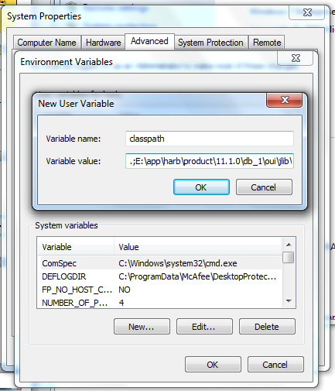
Setting up classpath (Contd.).

Slide 19
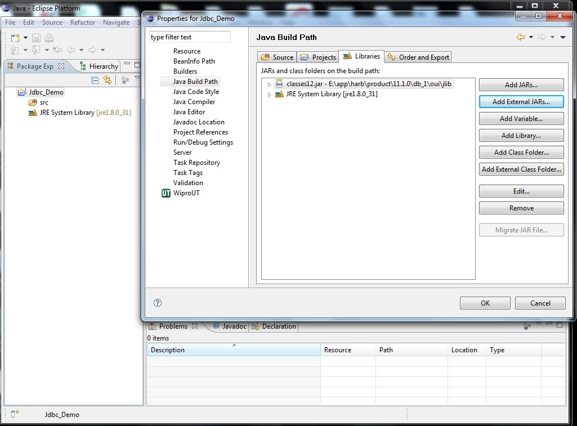
Setting up classpath (Contd.).
If you are using eclipse IDE, then it will not recognize the environment variable, classpath. You will have to add classes12.jar, as an external jar file to the build path.

Slide 20
Example
import java.sql.*; class MakeConnection1{
Connection con;
Statement stmt; ResultSet rs; MakeConnection1(){
try{
Class.forName("oracle.jdbc.driver.OracleDriver"); con=DriverManager.getConnection
("Jdbc:Oracle:thin:@localhost:1521:ORCL","scott","tiger");
stmt=con.createStatement(); rs=stmt.executeQuery("Select ename, sal from emp"); while(rs.next())
System.out.println(rs.getString(1)+" "+rs.getInt(2));
contd..

Slide 21
Example (Contd.).
conn.close();
} // end of try block catch(SQLException e){
System.out.println(e);
}
catch(ClassNotFoundException e){ System.out.println(e);
}
}
}
public class TestConnection1{
public static void main(String args[]){ new MakeConnection1();
}
}

Slide 22
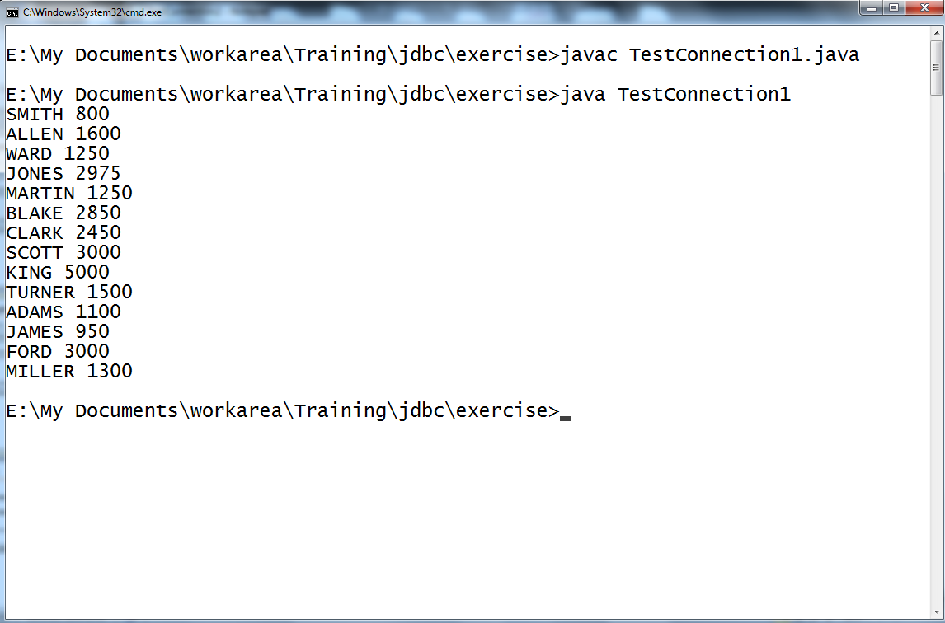
Example (Contd.).

Slide 23

Quiz
What does the next() method invoked on the result set object return
  String
  int
  boolean
  float
Which one of the following method can be invoked on the connection object to create an empty Statement object
createStatement();
getStatement();
prepareStatement();
executeStatement();
Answers :
: c
: a

Slide 24






Close Connection
Connect
Query
Close the result set
Process results
Close the statement
Close
Close the connection

Slide 25
Close Connection
Normally, nothing needs to be done to close a ResultSet object; it is automatically closed by the Statement object that generated it when that Statement object is closed, is re-executed, or is used to retrieve the next result from a sequence of multiple results.
The method close() is provided so that a ResultSet object can be closed explicitly, thereby immediately releasing the resources held by the ResultSet object.
This could be necessary when several statements are being used and the automatic close does not occur soon enough to prevent database resource conflicts.

Slide 26
How to Close the Connection?
1. Close the ResultSet object
rset.close();
2. Close the Statement object
stmt.close();
3. Close the connection
conn.close();

Slide 27
How to Close the Connection?
When a connection is in auto-commit mode, the statements being executed within it are committed or rolled back when they are completed. A statement is considered complete when it has been executed and all its results have been returned.
For the method executeQuery, which returns one result set, the statement is completed
when all the rows of the ResultSet object have been retrieved.
For the method executeUpdate, a statement is completed when it is executed. In the rare cases where the method execute is called, however, a statement is not complete until all of the result sets or update counts it generated have been retrieved.

Slide 28
How to Close the Connection?
Statement objects will be closed automatically by the Java garbage collector. Nevertheless, it is recommended as good programming practice that they be closed explicitly when they are no longer needed. This frees DBMS resources immediately and helps avoid potential memory problems.
The same connection object can be used to execute multiple statements and retrieve many result sets. However, once all the work with the database is over, it is a good programming practice to close the connection explicitly. If this is not closed, after a particular timeout period defined at the database, the connection is automatically closed. Nevertheless, this would mean that till the timeout, this connection is not available to any other users of the database. Hence, explicit closing of the connection is recommended.

Slide 29

Quiz
Which of the following methods is not used for querying database?
  executeQuery()
  executeStatement()
  executeUpdate()
  execute()
Which of the method is used to close a connection?
  connection.close();
  connection.terminate();
  connection.exit();
d. None of the above
Answers:
B
A

Slide 30

Thank You

